Slide 1

Project: Fake Content Detection
Advanced Machine Learning for Identifying Fake News, Manipulated Images, and Deepfake Videos
Intro: The growing threat of disinformation requires automated detection systems.
- By Logic Legends

Slide 2
The Challenge: Evolving Deception
Escalating Spread
Key Stats
Fake news spreads quickly
Fake news retweets: +70%
Deepfakes are on the rise
Deepfake incidents: +900%
Hard to identify fake news
Adults fooled: 64%

Slide 3




Text Analysis: Unmasking Narratives
Natural Language Processing (NLP)
Detect anomalies in text
Sentiment Analysis
Identify biased language
Source Verification
Assess credibility
Example: NLP algorithms detect fabricated articles with 95% accuracy.

Slide 4
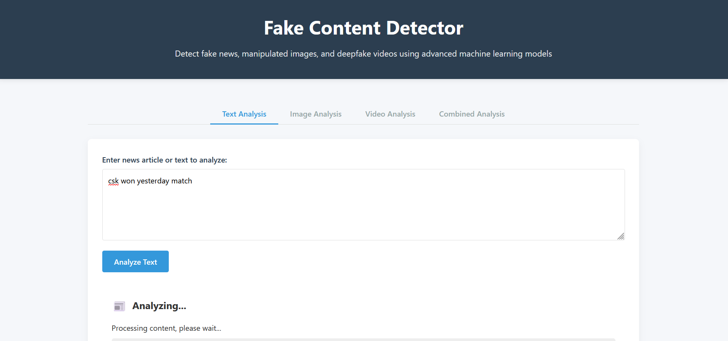
Text Analysis: Unmasking Narratives

Slide 5




Image Analysis: Exposing Deceptions
Metadata Analysis
Find inconsistencies
Reverse Image Search
Compare images
Error Level Analysis (ELA)
Identify alterations
Example: ELA identifies manipulated image with 98% accuracy.

Slide 6
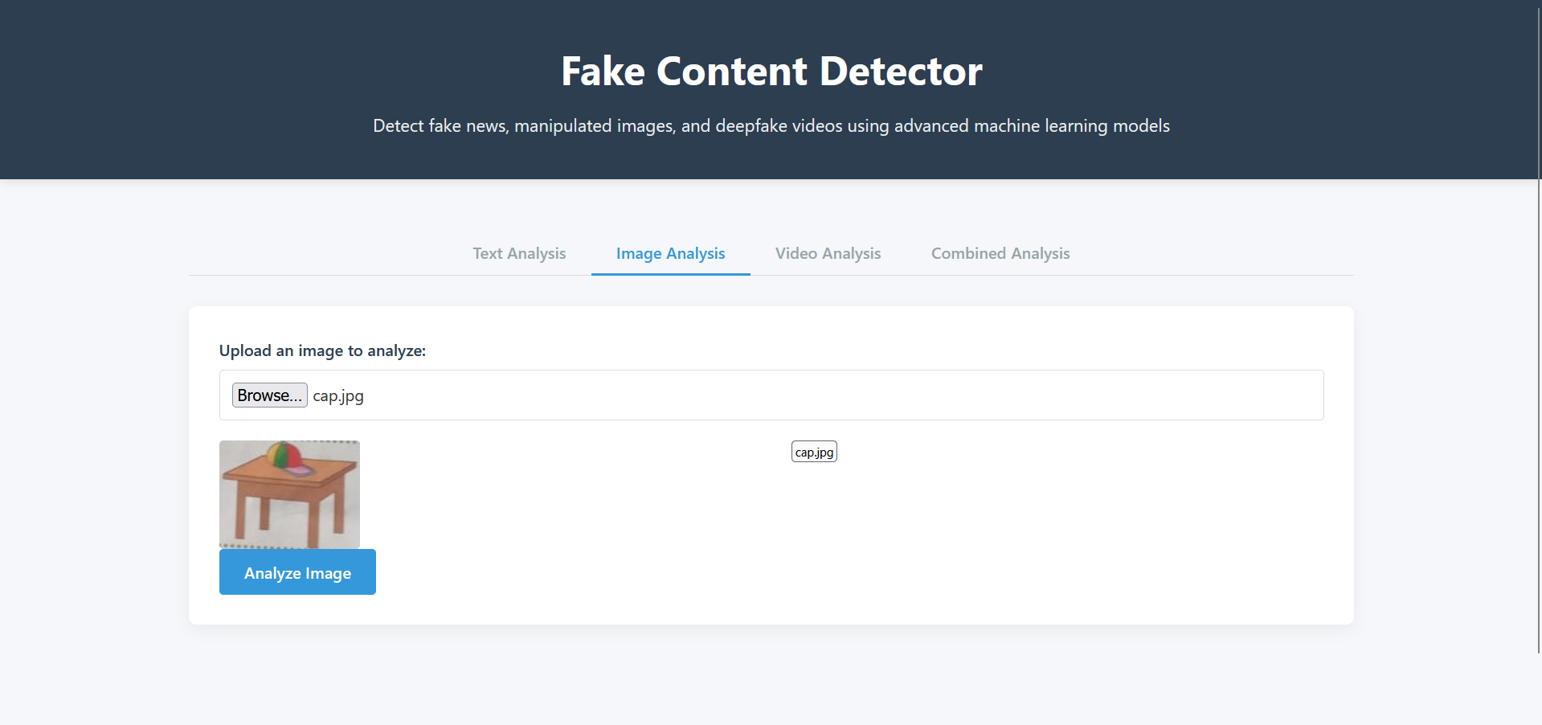
Image Analysis: Exposing Deceptions

Slide 7



Video Analysis: Detecting Deepfakes
Facial Action Coding (FACS)
Audio Analysis
Temporal Analysis
Example: Detect deepfake video with 99% accuracy using FACS and audio analysis.

Slide 8
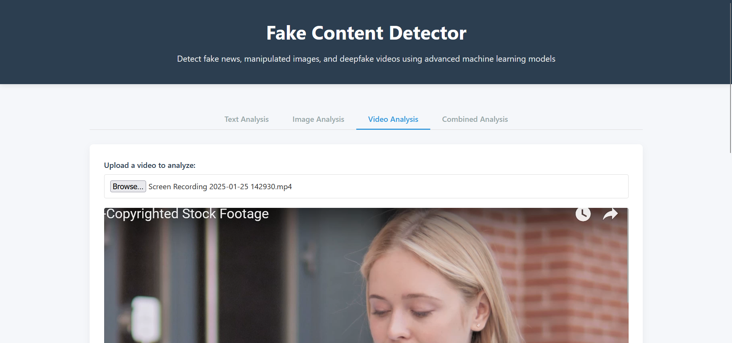
Video Analysis: Detecting Deepfakes

Slide 9

Combined Analysis: Superior Detection
Multi-Modal Fusion
Bayesian Networks
Combine text, image, and video results
Model probabilistic relationships
Ensemble Learning
Combine multiple models
Example: Improves accuracy to 99.5% by combining multiple sources.

Slide 10
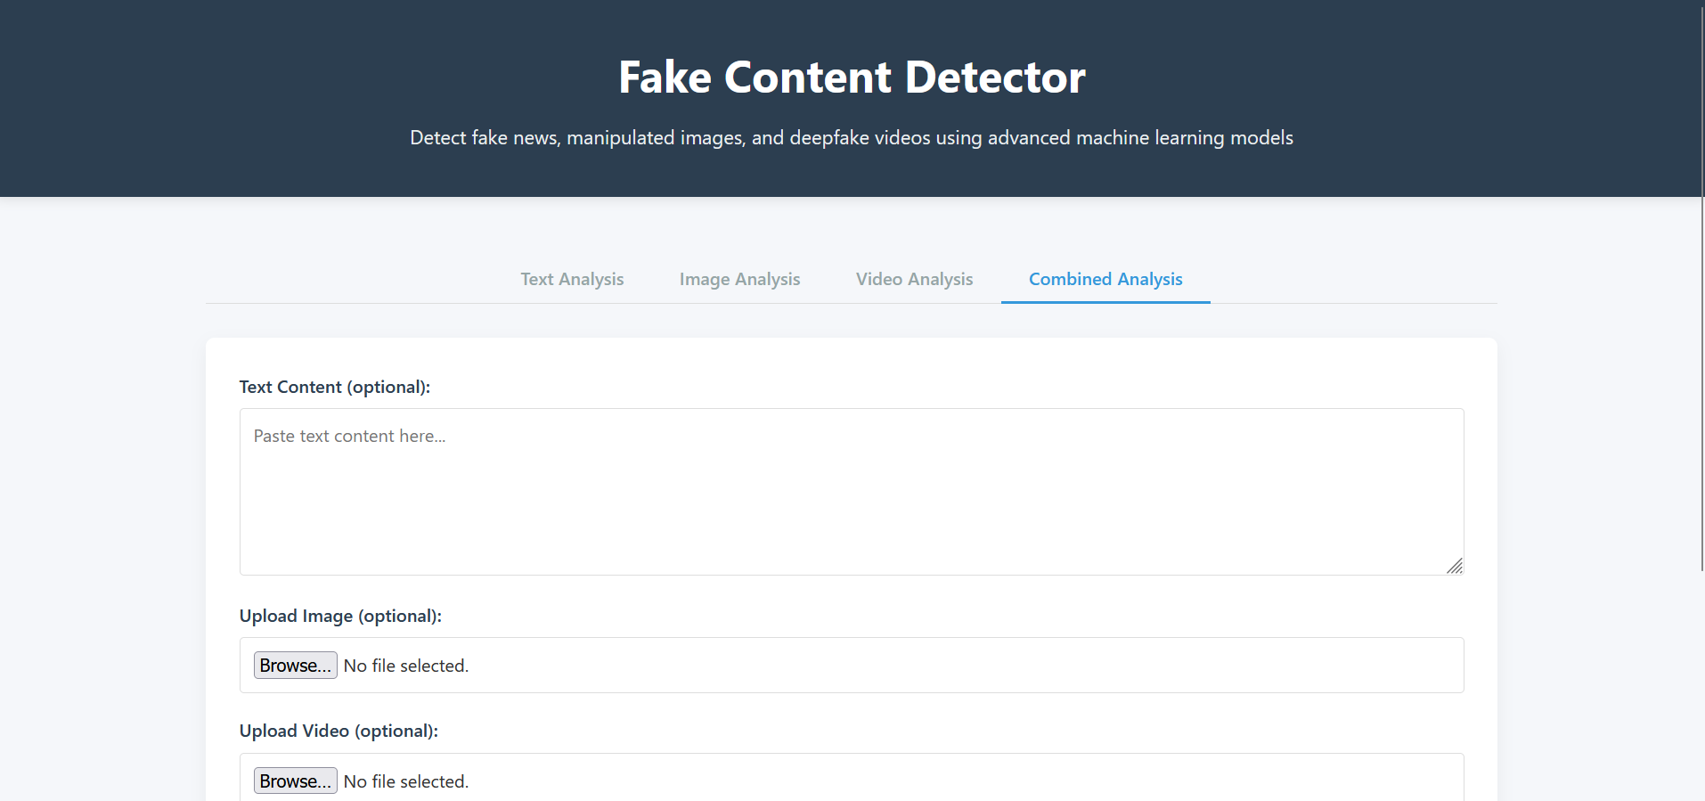
Combined Analysis: Superior Detection

Slide 11
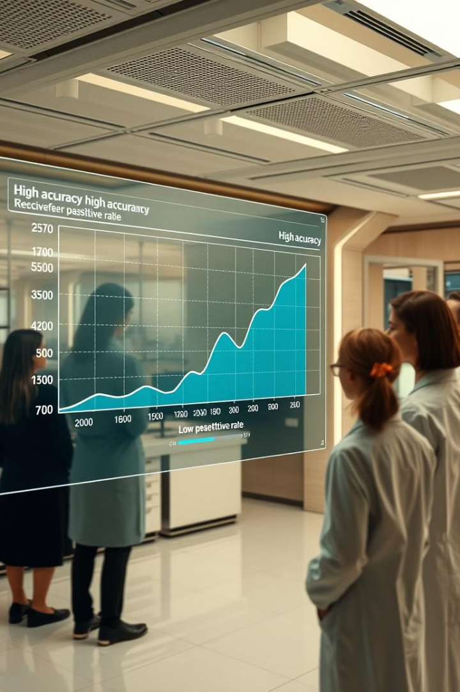
Project Performance & Impact
99.5%
0.1%
Overall Accuracy
False Positive Rate
High detection rate
Minimize misidentification
Real-time
Processing Speed
Analysis with minimal latency

Slide 12

Empowering Truth in the Digital Age
Importance
Power
Automated fake content detection
Advanced machine learning techniques
Commitment
Ongoing innovation
Call to Action: Promote media literacy and initiatives that combat fake content.

